Slide 1
Sequential Logic Design

Slide 2
Bit Storage Summary
SR latch
Level-sensitive SR latch
D latch
D flip-flop
S (set)
S
S1
D
S
D latch
D latch
D
Dm
Qm
Ds
Qs’
Q
’
C
C
Q
C
m
Cs
Qs
Q
R
Q
Q
master
servant
R (reset)
R1
R
Clk
Feature: S=1 sets Q to 1, R=1 resets Q to 0. Problem: SR=11 yield undefined Q.
Feature: S and R only have effect when C=1. We can design outside circuit so SR=11 never happens when C=1. Problem: avoiding SR=11 can be a burden.
Feature: SR can’t be 11 if D is stable before and while C=1, and will be 11 for only a brief glitch even if D changes while C=1. Problem: C=1 too long propagates new values through too many latches: too short may not enable a store.
Feature: Only loads D value present at rising clock edge, so values can’t propagate to other flip-flops during same clock cycle. Tradeoff: uses more gates internally than D latch, and requires more external gates than SR – but gate count is less of an issue today.
We considered increasingly better bit storage until we arrived at the robust D flip-flop bit storage

Slide 3
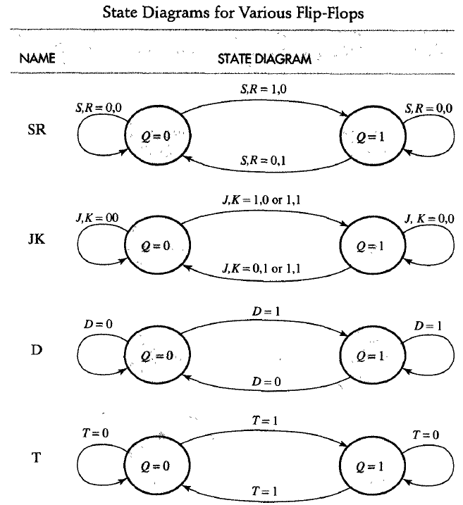

Slide 4
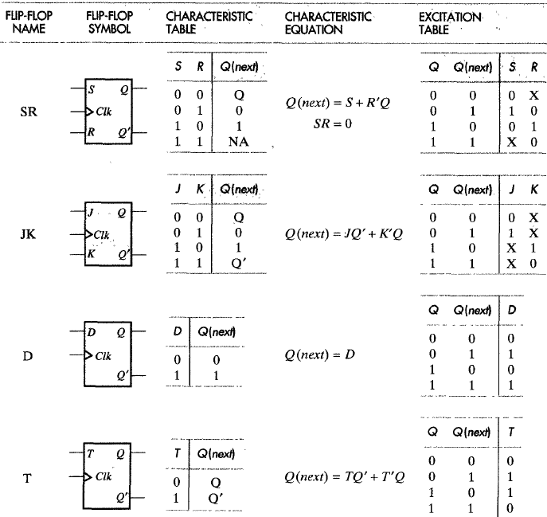

Slide 5
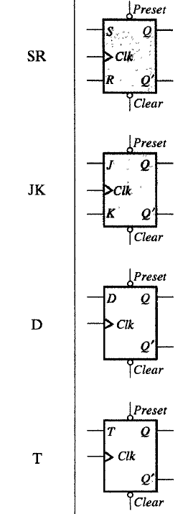
Preset and Clear

Slide 6
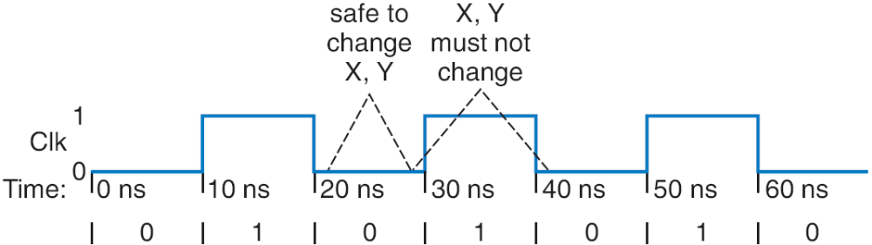
Clocks
Clock period: time interval between pulses
  Above signal: period = 20 ns
Clock cycle: one such time interval
  Above signal shows 3.5 clock cycles
Clock frequency: 1/period
  Above signal: frequency = 1 / 20 ns = 50 MHz
    1 Hz = 1/s
Freq
Period
100 GHz
0.01 ns
10 GHz
0.1 ns
1 GHz
1 ns
100 MHz
10 ns
10 MHz
100 ns

Slide 7
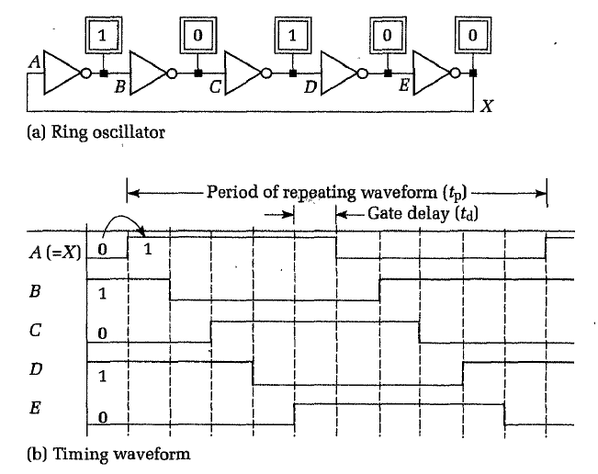
Clock Generation-Ring Oscillator
1ns delay for inverter
Frequency=1/2*n*td
Frequency=1/2*5*1n= 100Mhz

Slide 8
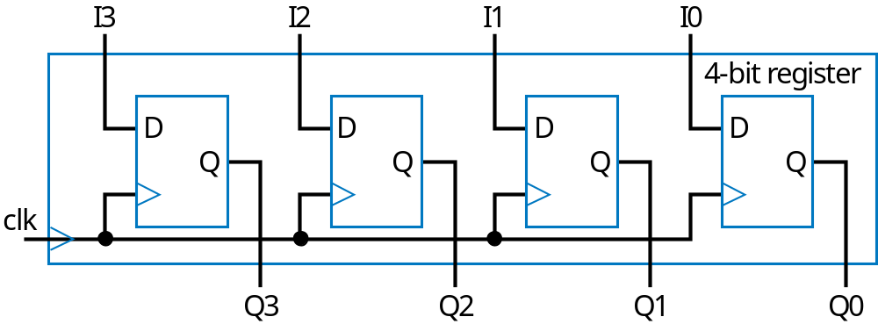
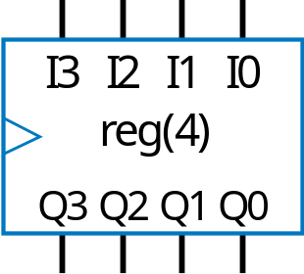
Basic Register
Typically, we store multi-bit items
  e.g., storing a 4-bit binary number
Register: multiple flip-flops sharing clock signal
  From this point, we’ll use registers for bit storage
    No need to think of latches or flip-flops
    But now you know what’s inside a register

Slide 9
Shift Registers
Shift registers
Parallel/serial format conversion
  SISO (serial in serial out)
  SIPO (serial in parallel out)
  PISO (parallel in serial out)
  PIPO (parallel in parallel out)

Slide 10
Shift Register
1 1 0 1
Register contents
Shift right
  Move each bit one position right
  Shift in 0 to leftmost bit
before shift right
0
a
0 1 1 0
Register contents
after shift right
Q: Do four right shifts on 1001, showing value after each shift
A:
1001 (original)
a
0100
0010
Implementation: Connect flip-flop output to next flip-flop’s input
0001
shr_in
a
0000

Slide 11
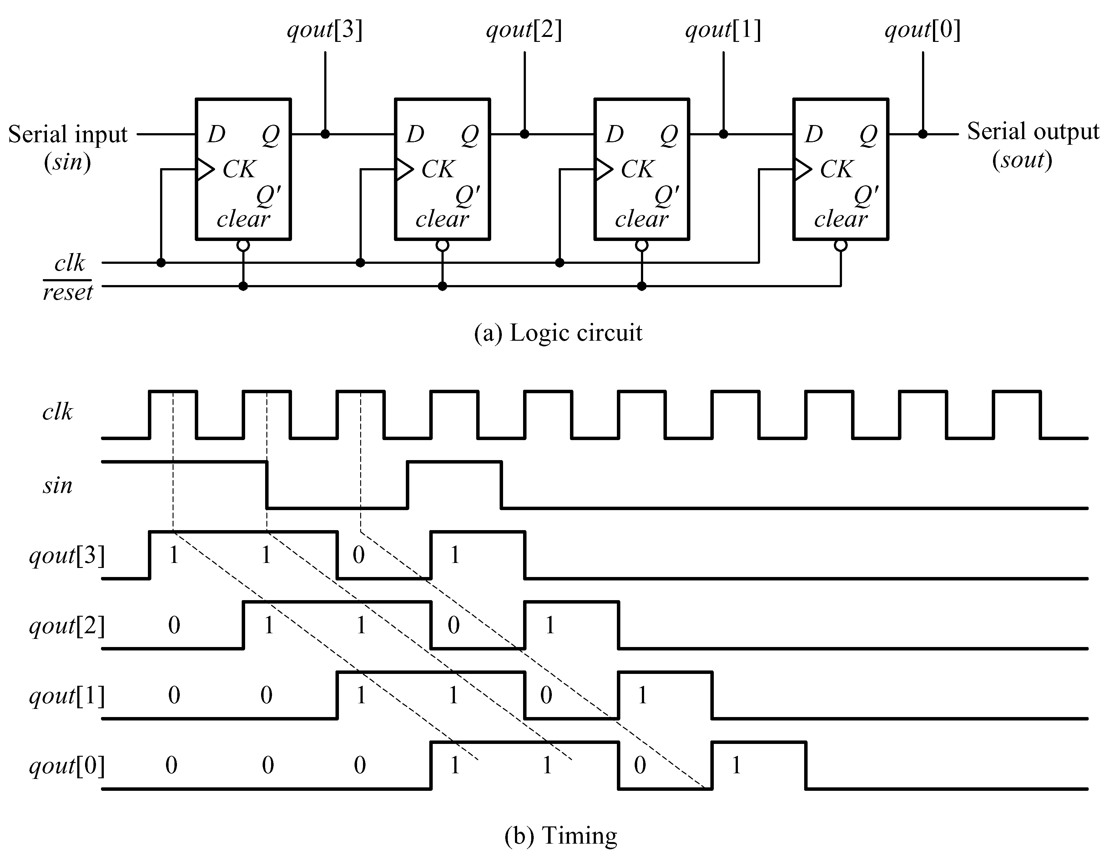
Shift Registers

Slide 12
Example Using Registers: Temperature Display
Temperature history display
  Sensor outputs temperature as 5-bit binary number
  Timer pulses C every hour
  Record temperature on each pulse, display last three recorded values
Present
1 hour ago
2 hours ago
Display
Display
Display
x4
a4
a3
a2
a1
a0
b4
b3
b2
b1
b0
c4
c3
c2
c1
c0
x3
x2
x1
TemperatureHistoryStorage
x0
timer
C

Slide 13
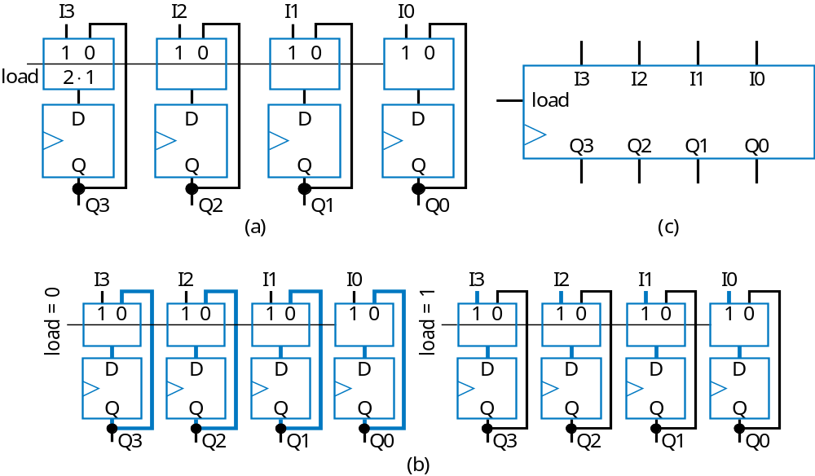
Register with Parallel Load
Add 2x1 mux to front of each flip-flop
Register’s load input selects mux input to pass
  Either existing flip-flop value, or new value to load

Slide 14
Basic Example Using Registers
a3
a2
a1
a0
This example will show how registers load simultaneously on clock cycles
  Notice that all load inputs set to 1 in this example -- just for demonstration purposes
1
ld
I
3
I
2
I
1
I
0
clk
R0
Q3
Q2
Q1
Q0
1
ld
I
3
I
2
I
1
I
0
1
ld
I
3
I
2
I
1
I
0
R1
R2
Q3
Q2
Q1
Q0
Q3
Q2
Q1
Q0

Slide 15
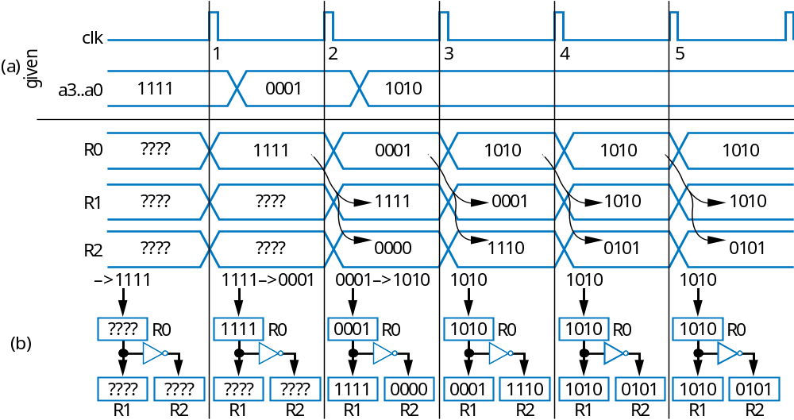
Basic Example Using Registers
a3
a2
a1
a0
I
3
I
2
I
1
I
1
ld
0
clk
Q3
Q2
Q1
R0
Q0
I
3
I
2
I
1
I
0
I
3
I
2
I
1
I
1
ld
1
ld
0
R1
R2
Q3
Q2
Q1
Q0
Q3
Q2
Q1
Q0

Slide 16

Register Example using the Load Input:
Weight Sampler
Scale has two displays
  Present weight
  Saved weight
  Useful to compare present item with previous item
Use register to store weight
  Pressing button causes present weight to be stored in register
    Register contents always displayed as “Saved weight,” even when new present weight appears
Scale
Weight Sampler
0
0
0
0
1
1
1
0
Save
b
1
I
3
I
2
I
1
I
0
3 KG
load
0
0
1
1
a
2 KG
Present weight
clk
Q3
Q2
Q1
Q0
3 KG
Saved weight

Slide 17
Register Example: Temperature History Display
example
  Timer pulse every hour
  Previously used as clock. Better design only connects oscillator to clock inputs -- use registers with load input, connect to timer pulse.
a4
a3
a2
a1
a0
b4
b3
b2
b1
b0
c4
c3
c2
c1
c0
a4
a3
a2
a1
a0
b4
b3
b2
b1
b0
c4
c3
c2
c1
c0
t4
I
4
Q4
I
4
Q4
I
4
Q4
I
I
4
Q4
I
4
Q4
I
4
Q4
x4
3
Q3
I
3
Q3
I
3
Q3
t3
I
I
3
Q3
I
3
Q3
I
3
Q3
x3
2
Ra
Q2
I
2
Rb
Q2
I
2
Rc
Q2
t2
I
I
2
Q2
I
2
Q2
I
2
Q2
x2
1
Q1
I
1
Q1
I
1
Q1
t1
I
I
1
Q1
I
1
Q1
I
1
Q1
x1
0
Q0
I
0
Q0
I
0
Q0
t0
I
0
Q0
I
0
Q0
I
0
Q0
x0
ld
ld
ld
osc
C
Clk
R
a
R
b
R
c
C
TemperatureHistoryStorage
a
timer
new line
TemperatureHistoryStorage

Slide 18
Example Using Registers: Temperature Display
Use three 5-bit registers
a4
a3
a2
a1
a0
b4
b3
b2
b1
b0
c4
c3
c2
c1
c0
x4
I
4
Q4
I
4
Q4
I
4
Q4
x3
I
3
Q3
I
3
Q3
I
3
Q3
x2
I
2
Q2
I
2
Q2
I
2
Q2
x1
I
1
Q1
I
1
Q1
I
1
Q1
x0
I
0
Q0
I
0
Q0
I
0
Q0
C
R
a
R
b
R
c
TemperatureHistoryStorage
x4...x0
15
18
20
21
21
22
24
24
24
25
25
26
26
26
27
27
27
27
C
R
a
0
18
21
24
25
26
27
R
b
0
0
18
21
24
25
26
R
c
0
0
0
18
21
24
25

Slide 19
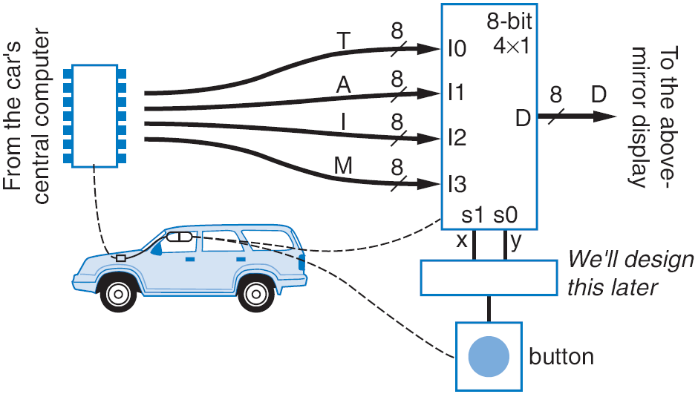
Register Example: Above-Mirror Display
8
Shorthand notation
0001010
a
C
8
Loaded on clock edge
d0
load
r
eg0
T
2
⋅
4
i0
0
1
8
example: Four simultaneous values from car’s computer
To reduce wires: Computer writes only 1 value at a time, loads into one of four registers
  Was: 8+8+8+8 = 32 wires
  Now: 8 +2+1 = 11 wires
d1
load
8-bit
r
eg1
A
×
a1
0001010
4
1
i0
i1
1
i1
8
a0
d2
load
r
eg2
d
D
I
8
i2
8
d3
load
r
eg3
M
1
e
load
i3
s1
s0
8
x
y

Slide 20
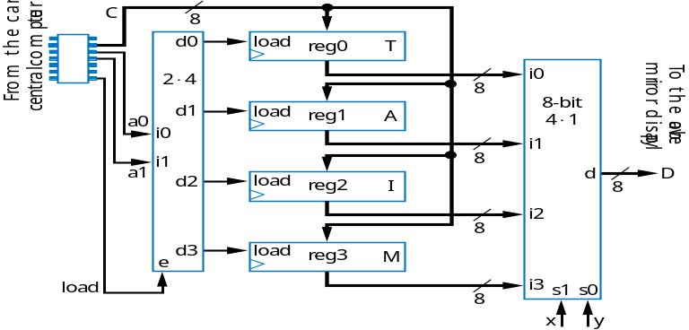
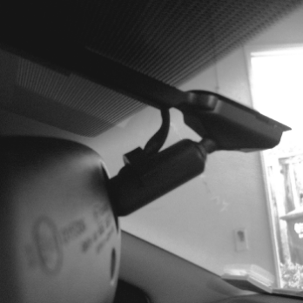
Shift Register Example: Above-Mirror Display
Earlier example: 8 +2+1 = 11wires from car’s computer to above-mirror display’s four registers
  Better than 32 wires, but 11 still a lot -- want fewer for smaller wire bundles
Use shift registers
  Wires: 1+2+1=4
  Computer sends one value at a time, one bit per clock cycle
11 wires
Note: this line is 1 bit, rather than 8 bits like before
c
x
y
shr_in
d0
shr
r
eg0
T
s1
s0
2
⋅
4
i0
shr_in
8
shr
4
×
1
d1
r
eg1
A
a0
i0
i1
a1
i1
shr_in
8
shr
d
D
d2
r
8
eg2
I
i2
shr_in
8
d3
shr
r
e
eg3
M
shi
f
t
i3
8

Slide 21
Rotate Register
1 1 0 1
Register contents
Rotate right: Like shift right, but leftmost bit comes from rightmost bit
before shift right
1 1 1 0
Register contents
after shift right

Slide 22
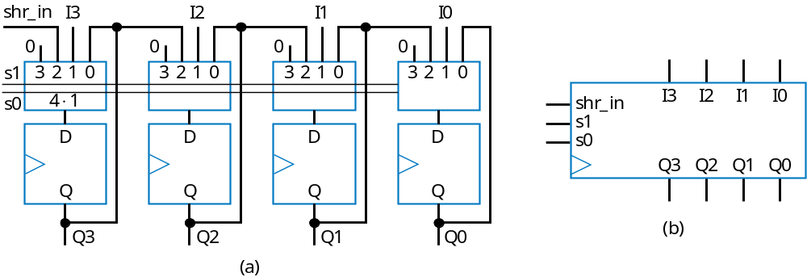
Multifunction Registers
Many registers have multiple functions
  Load, shift, clear (load all 0s)
  And retain present value, of course
Easily designed using muxes
  Just connect each mux input to achieve desired function
Functions:
s1
s0
Operation
0
0
Maintain present value
0
1
Parallel load
1
0
Shift right
1
1
(unused - let's load 0s)

Slide 23
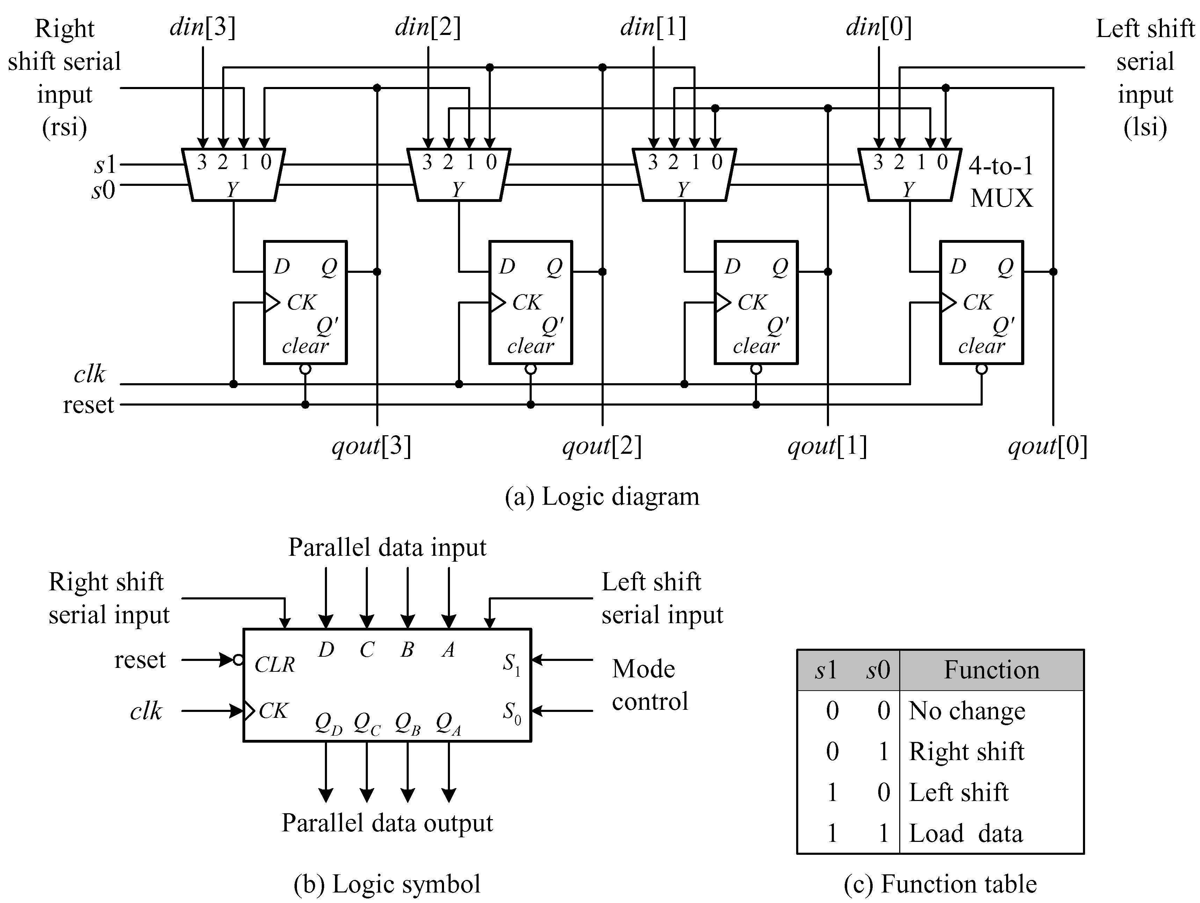
Universal Shift Registers

Slide 24
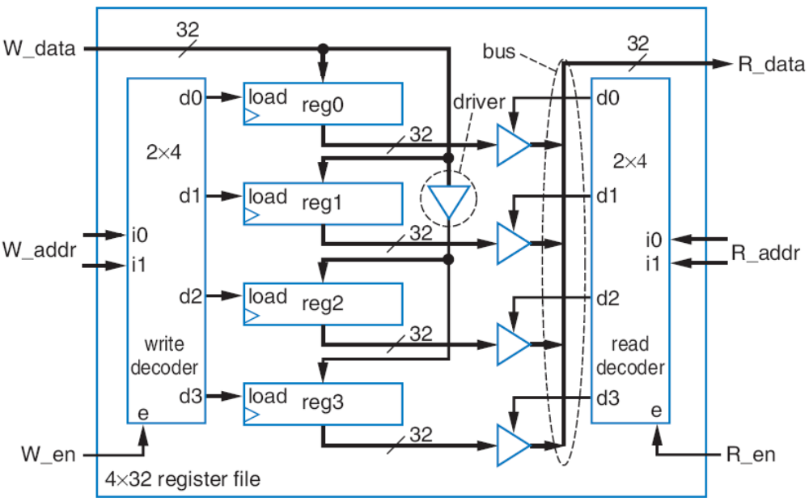
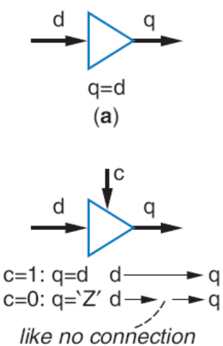
Register File
Instead, want component that has one data input and one data output, and allows us to specify which internal register to write and which to read
32
32
W_data
R_data
a
4
4
W_addr
R_addr
W_en
R_en
16
×
32
register file
a

Slide 25
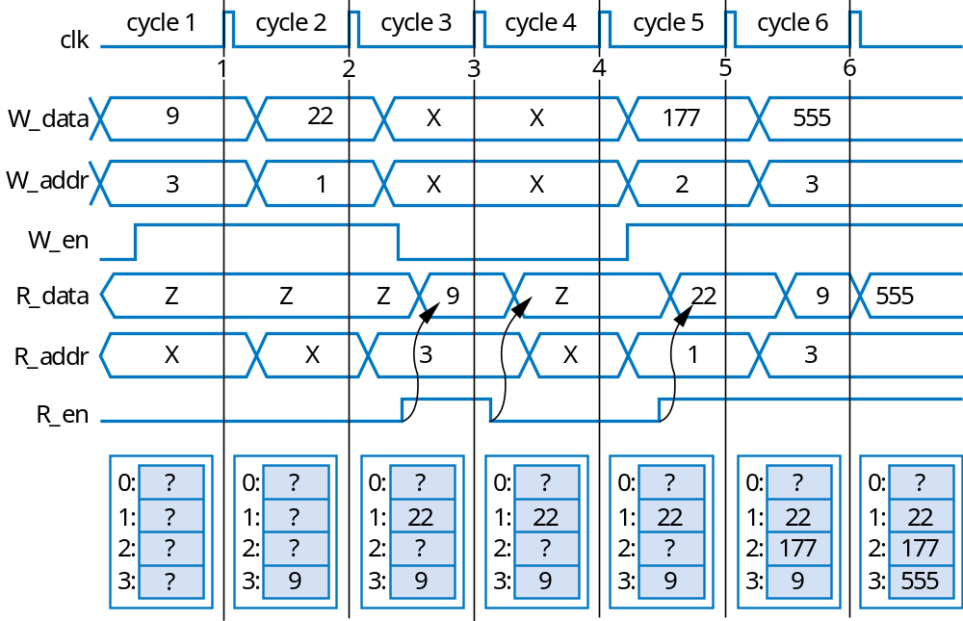
Register File Timing Diagram
Can write one register and read one register each clock cycle
  May be same register
32
32
W_data
R_data
2
W_addr
R_addr
2
W_en
R_en
4x32
register file

